Slide 1
Experience with making a FIFO in Verilog
Grace Luo 8/5/24

Slide 2
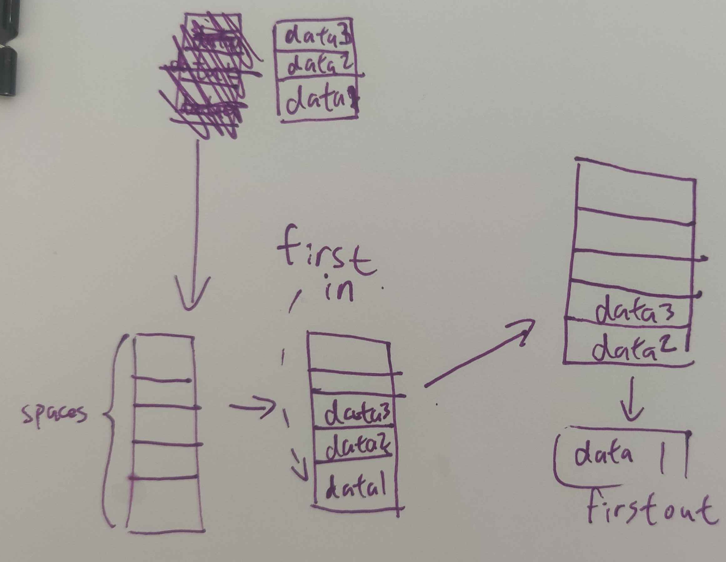
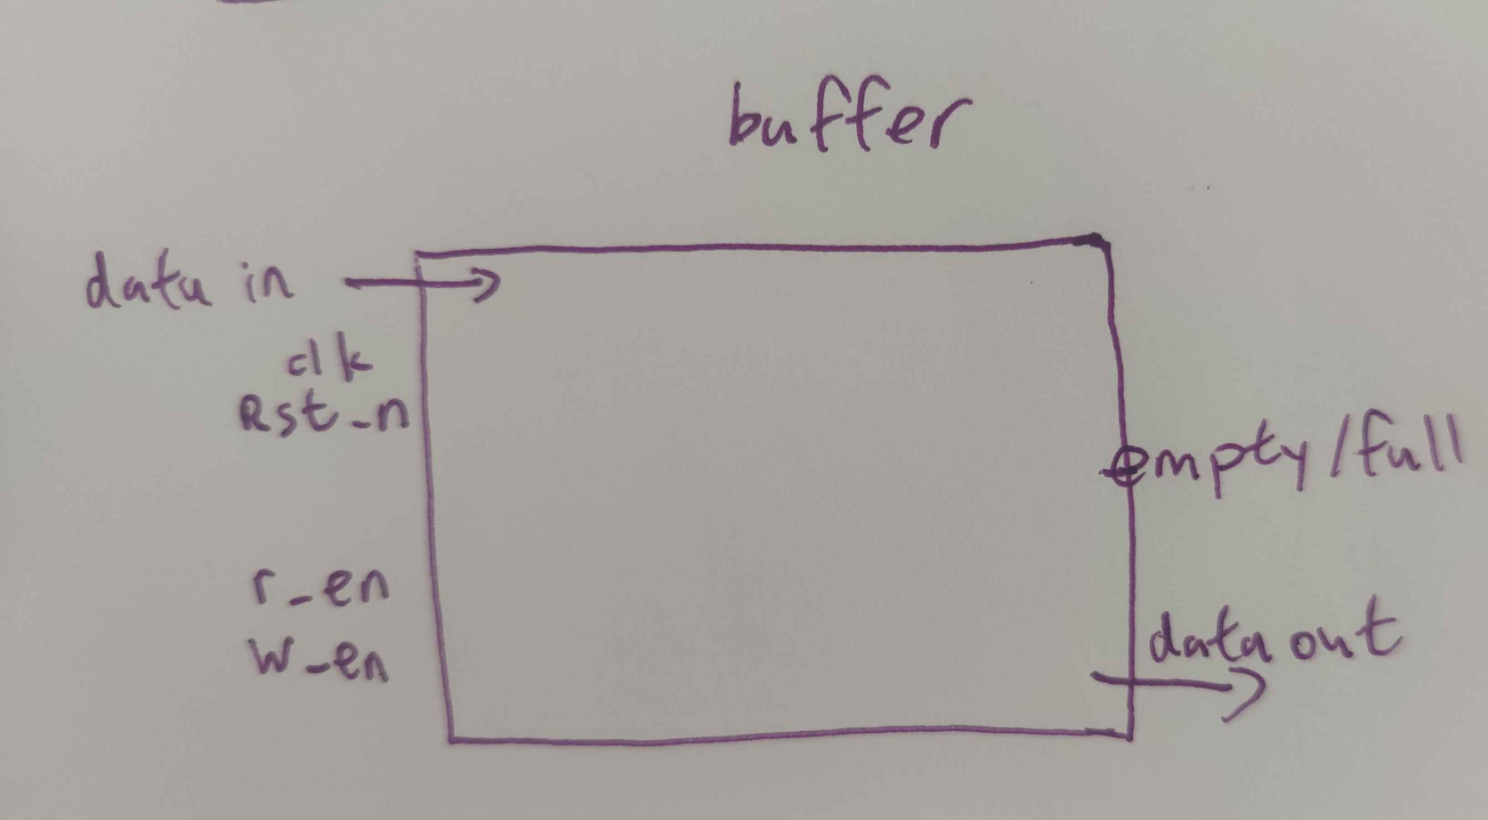
Notes:
often implemented as a circular queue, and has two pointers:

Slide 3
Difference between synchronous and asynchronous FIFO
Synchronous FIFO
Read and write are synchronous with common clk sig
Both have to be ready at the same time
Simpler to implement
Asynchronous FIFO
Read and write operations no need for clk
Progress async at own time
Needs to deal with the problems that come with different clock domains and sync read/write pointers
Notes:
Crossing clock domains can cause glitches and data loss

Slide 4
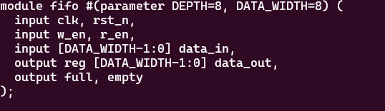

Explaining the code
Notes:
IN:
clk: Clock signal.
rst_n: Active-low reset signal.
w_en: Write enable signal.
r_en: Read enable signal.
data_in: Data to be written into the FIFO.
OUT::
data_out: Data read from the FIFO.
full: Indicates if the FIFO is full.
empty: Indicates if the FIFO is empty.
1 if true, 0 if false, as established last time
w_ptr, r_ptr: Pointers to track the write and read positions in the FIFO
Fifo: array to store the data.

Slide 5
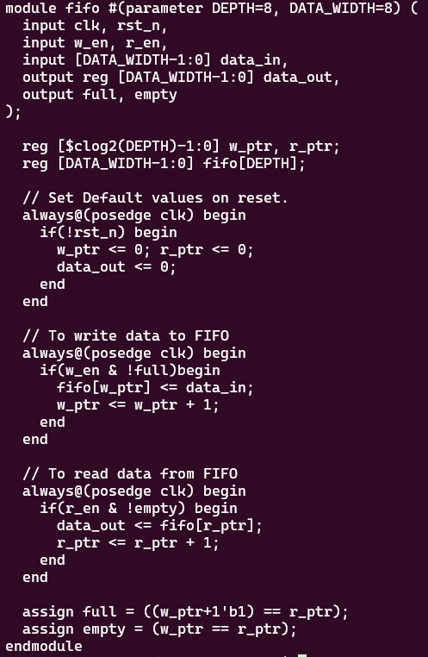
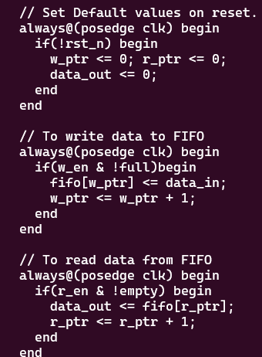
More optional explanation
Notes:
Reset Logic:
Initializes write and read pointers to 0 and data output to 0 on reset.
Write Logic:
If write enable is asserted and the FIFO is not full:
Writes the input data to the current write pointer location.
Increments the write pointer.
Read Logic:
If read enable is asserted and the FIFO is not empty:
Reads the data at the current read pointer location.
Increments the read pointer.

Slide 6
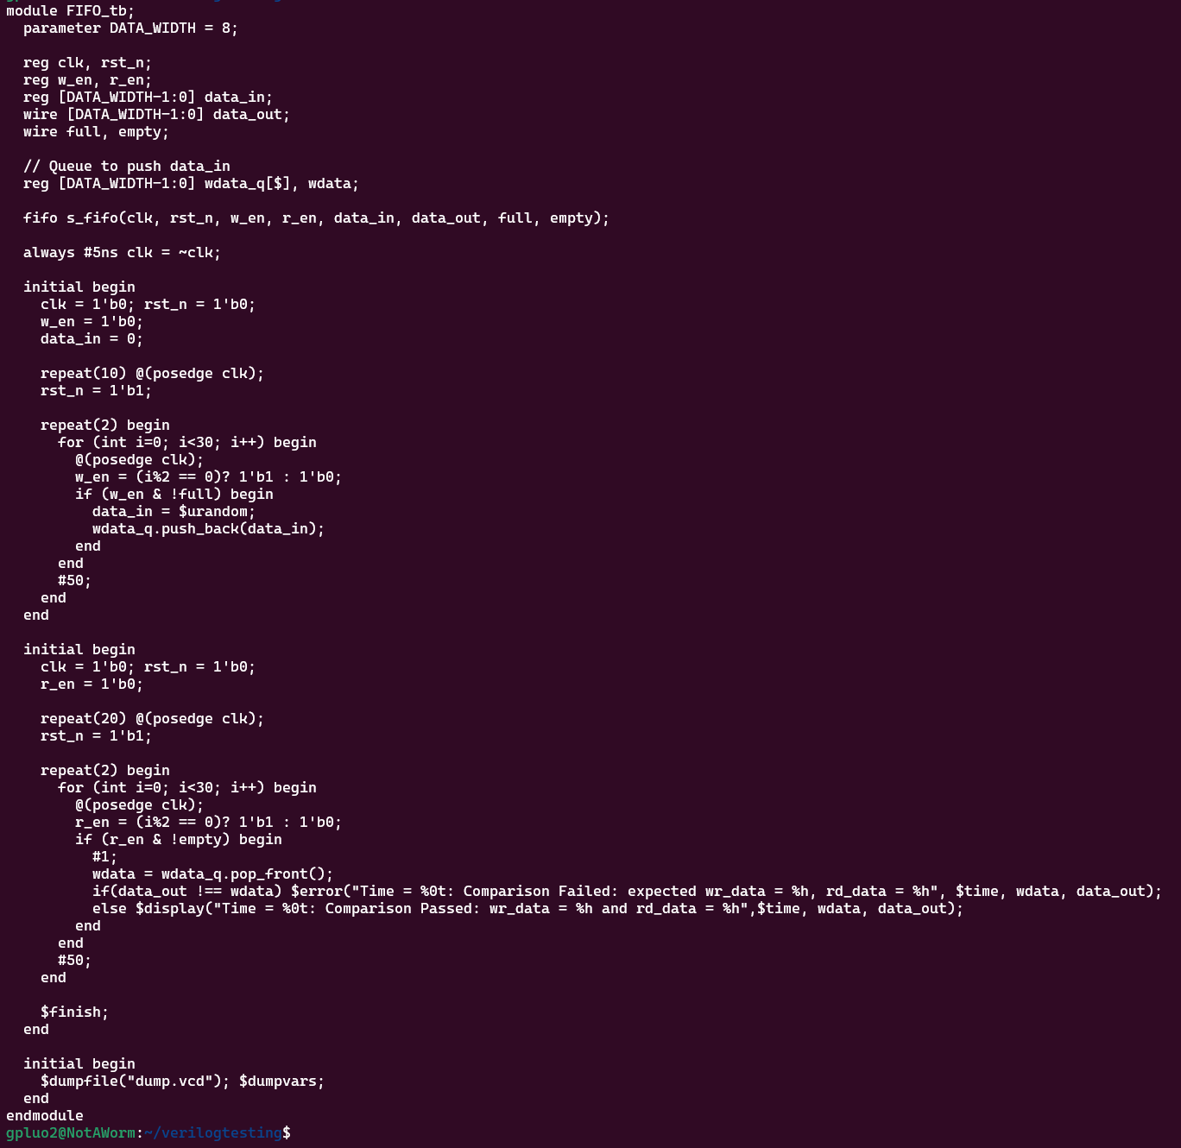
The testbench
Notes:
Posedge is positive edge: specifically used to trigger a block of code when a signal transitions from a low (0) to a high (1) value.

Slide 7
-Wall //strict warning
-j 0 //makes fully parallelized
--assert //enables system Verilog assertions
--trace-fst /dump as a FST (compressed version of the VCD
Afterwards used
verilator --binary ~/<location>/<name>.v ~/<location>/<test bench>.v --top <testbench name> -Wall -j 0 --assert --trace-fst --Wno-fatal
(i put this in the readme)

Slide 8
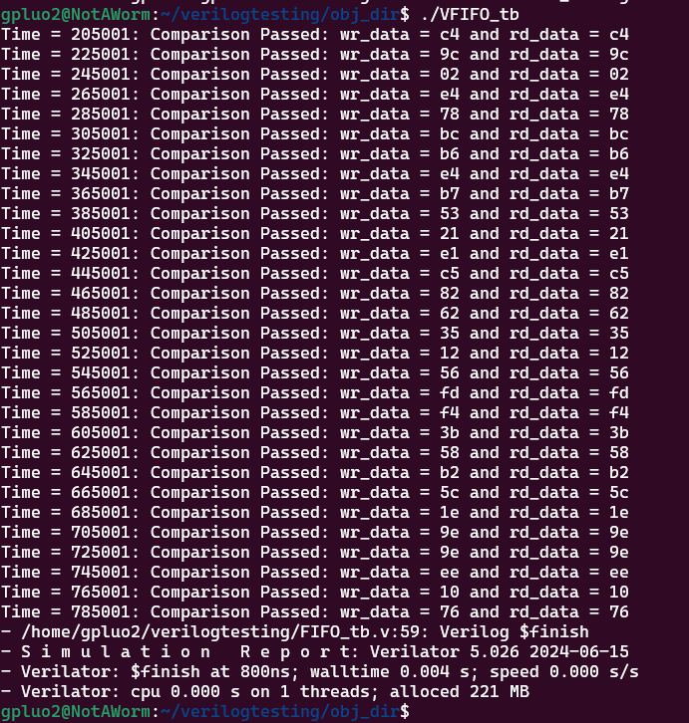
Result: after running the ./VFIFO_tb found in the obj dir
Ran the executable after checking for it in
the obj_dir/

Slide 9
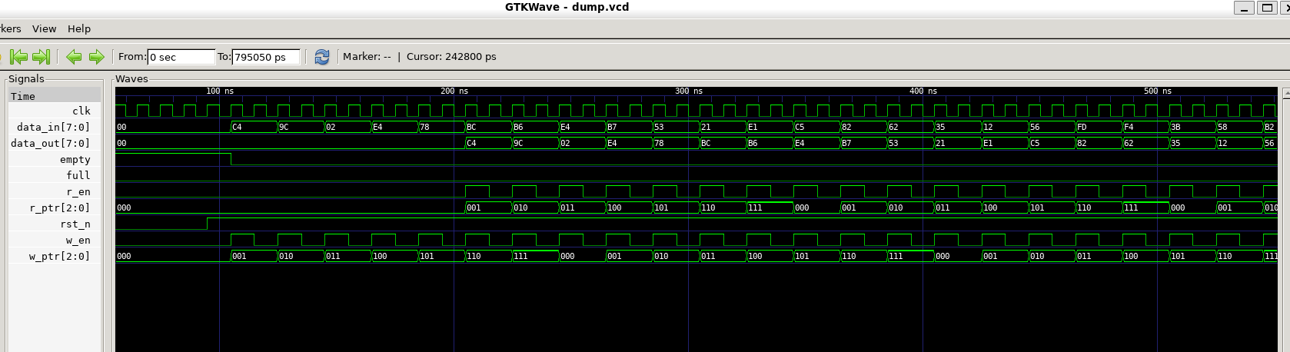
How it looks

Slide 10
References:
-https://esrd2014.blogspot.com/p/first-in-first-out-buffer.html

